Slide 1
Braceloc project

Slide 2
Presentation
Real-time location tracking, sharing
GPS position exchange
Emergency communication
No network coverage dependency
skin sensor integration
Objective: Enable offline location tracking and distress alerting for friends, family, and group members while ensuring the privacy of their positions from other groups.
This project involves a group of 3 people :
Nicolas Meyer (5A GPSE)
Florian Krasulja (4A GPSE)
Grace Ndoko-ounounou (4A GPSE)

Slide 3
Summary
Technical Solutions
Planning
Conclusion
Usage scenario

Slide 4
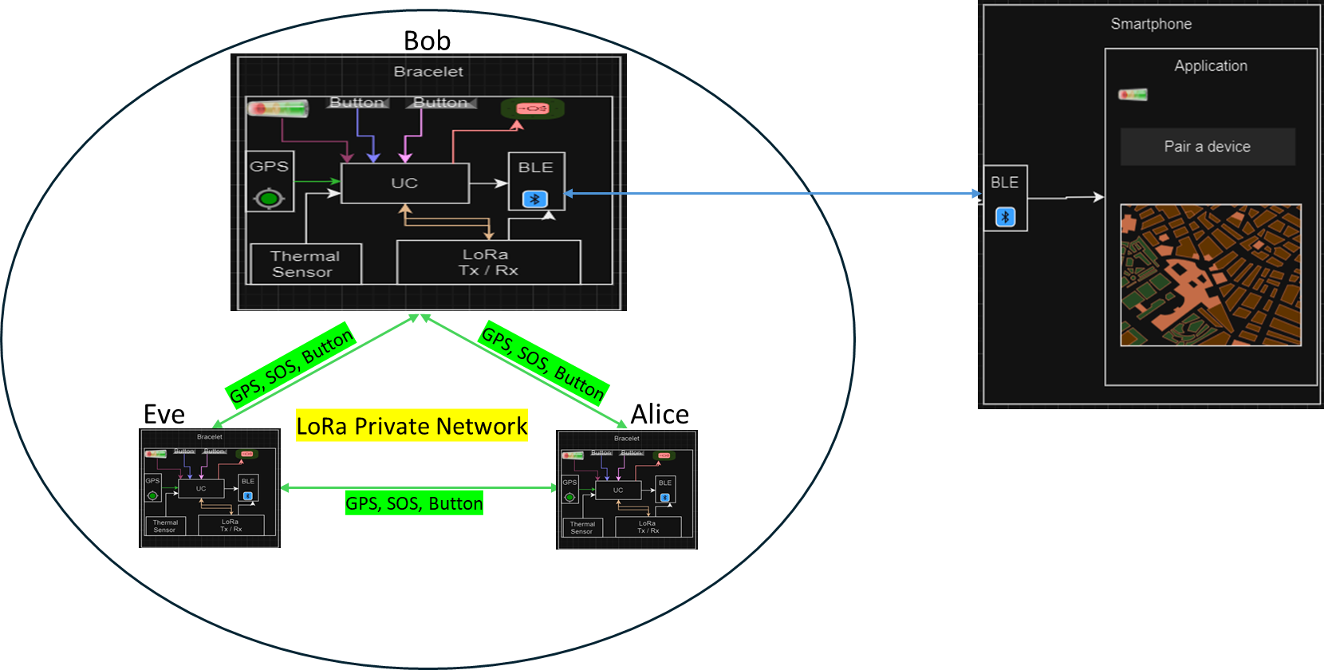
Usage scenario

Slide 5
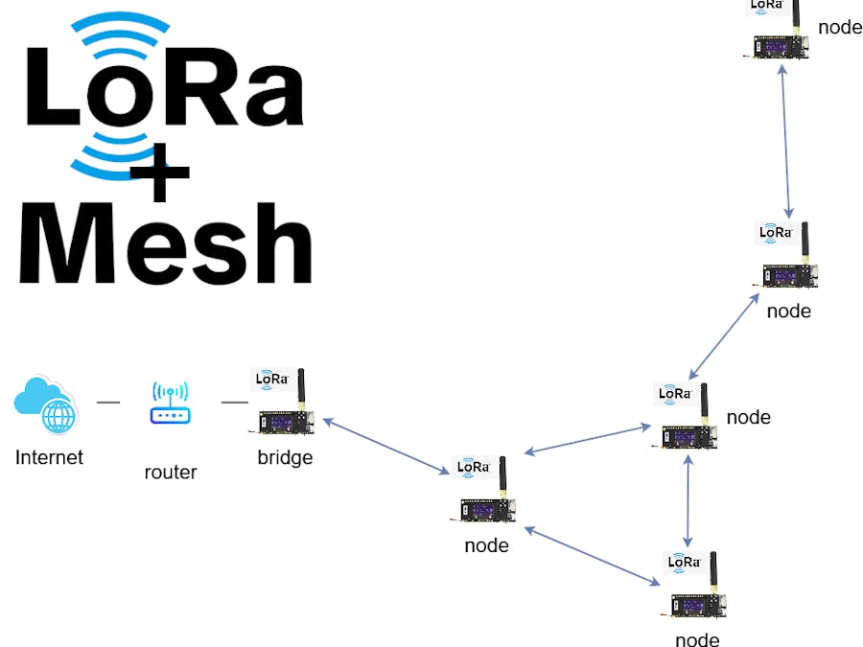
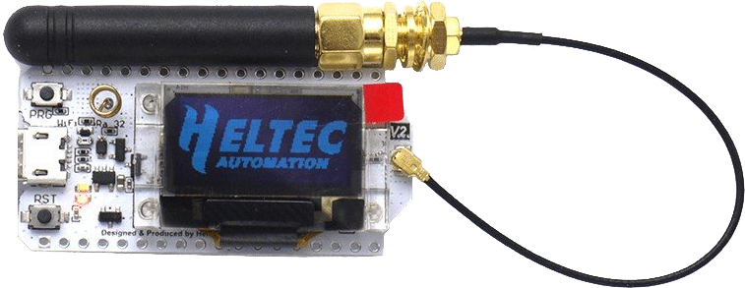
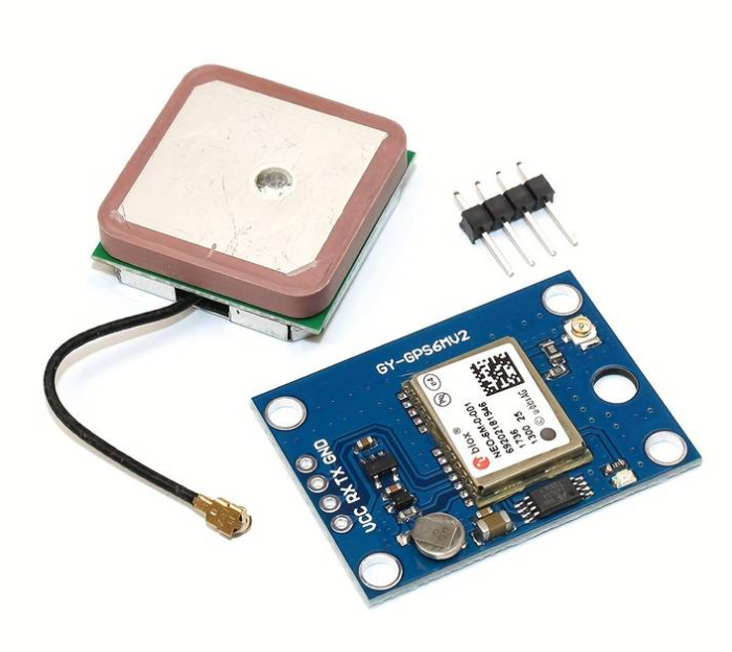
Technical solutions implemented: the LoRa Network & GPS sensor
Objective: Establish decentralized communication between two LoRa32 V3 Heltec modules using a private LoRa mesh network
Range: 1 km (urban), 5 km (rural).
GPS Integration
Low Power
Communication: Text messages, GPS data without cellular networks.
Heltec wifi lora 32 V3
GPS Sensor

Slide 6
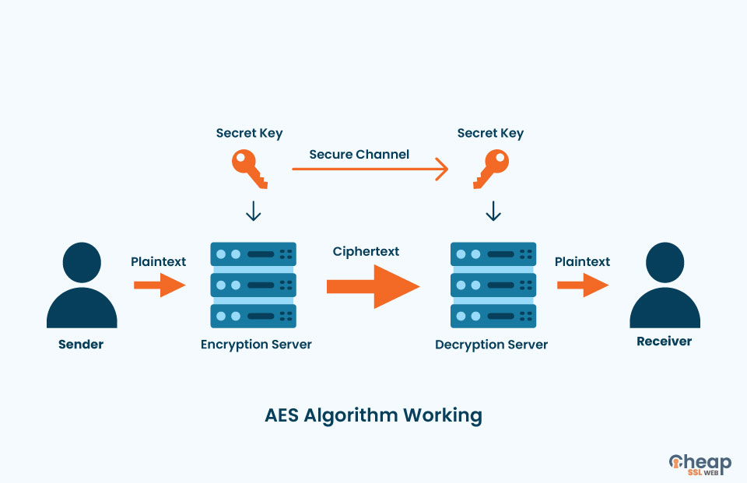
Technical solutions implemented: Advanced Encryption Standard
Objective: Establish secure communication between two LoRa32 V3 Heltec modules.
Widely used symmetric encryption for securing data
Same key is used for both encrypting and decrypting data
The different connected bracelets will possess the same key to encrypt data when sending and decrypt data when receiving.

Slide 7
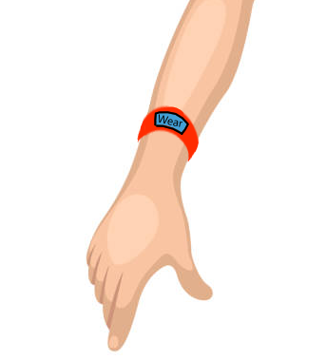
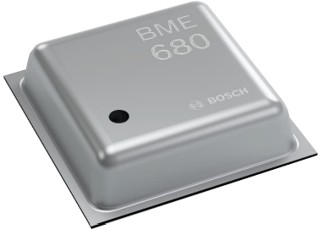
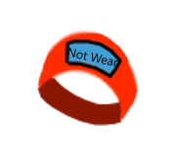


Technical solutions implemented: Skin Detection Sensor
Objective: Verify that the bracelet is properly worn by the user
Low Power Gas, pressure, temperature, humidity sensor.
Weight: 55 mg
Package: 2.5 mm x 2.5 mm x 0.93 mm
Operating range : -40 to +85 °C | 0 to 100 % humidity | 300 to 1100 hPa
Not wear
Wear

Slide 8


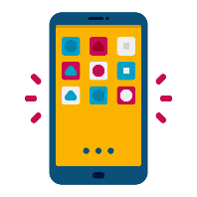

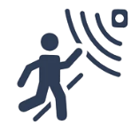
Task allocation & Planning
 | Name | Nicolas | Florian | Helioth | Start Date | End Date
 | Lora Network | X | X | X | 2/26/2024 | 3/29/2024
 | GPS Sensor |  | X |  | 3/29/2024 | 3/05/2024
 | Smartphone Application + BLE | X |  |  | 3/25/2024 | 3/12/2024
 | Security of data transmission |  |  | X | 3/26/2024 | 3/19/2024
 | Skin detection Sensor | X |  |  | 3/11/2024 | 3/19/2024

Slide 9
Conclusion
Test the LoRa network in real-life conditions.
Integrate GPS, 1 or 2 buttons, and 1 or 2 LEDs.
Include BLE and pairing function to transmit information to a smartphone (ensure proper reception of GPS, button, battery, zone limit/RSSI).
Develop the smartphone application (map, alerts, etc.).
Incorporate a skin detection sensor

Slide 10
Thank you for your attention

